Slide 1
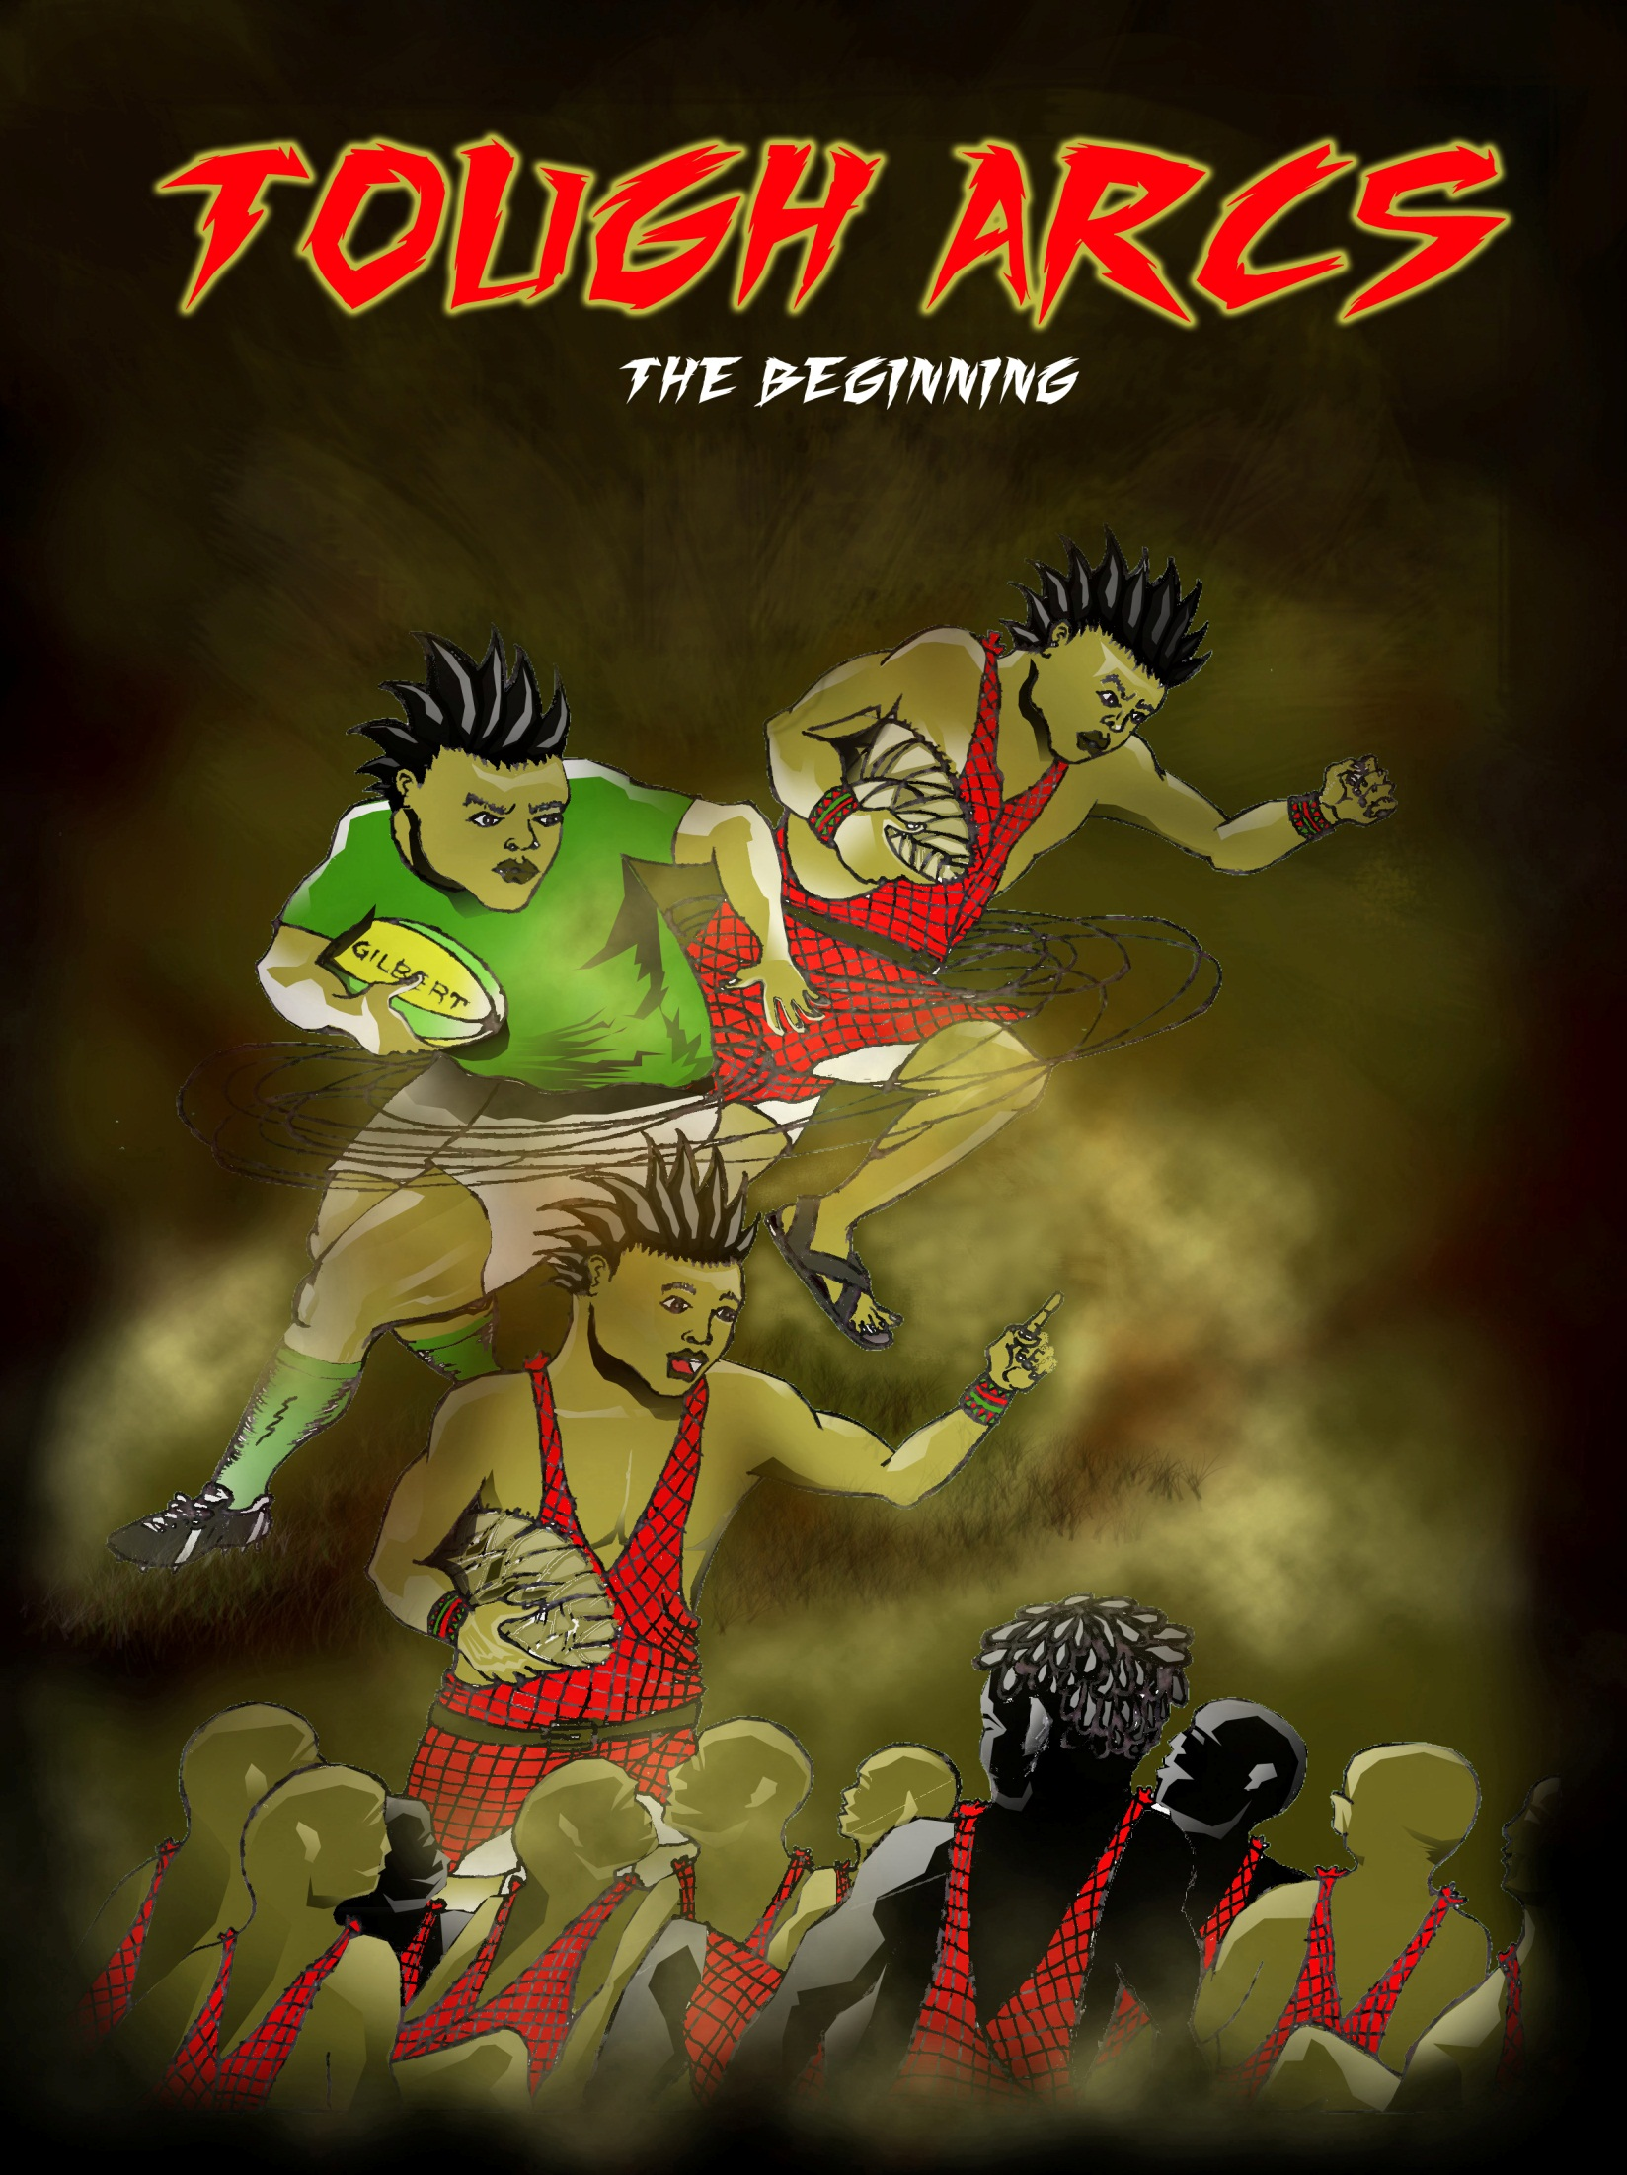

Slide 2

RUGBY
FOR THE LOVE OF THE GAME
JUST HOW DANGEROUS IS RUGBY?
IT’S A TEAM SPORT
THE MORE YOU SWEAT IN TRAINING THE LESS YOU BLEED IN BATTLE
ALL THE TALENT IN THE WORLD WONT TAKE YOU ANYWHERE WITHOUT YOUR TEAM MATES

Slide 3
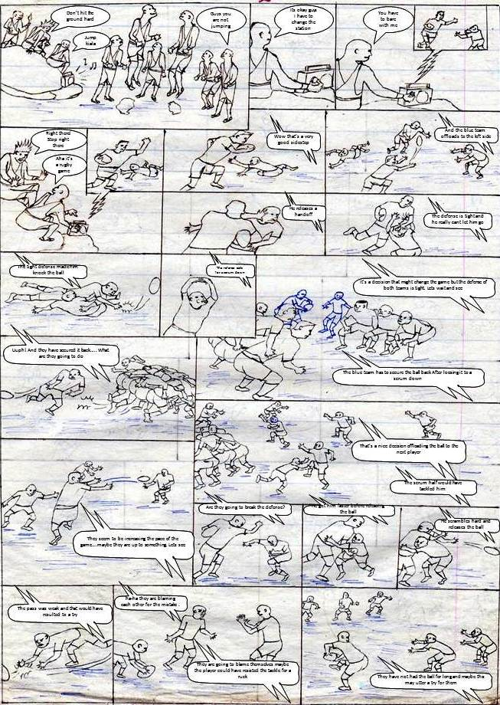

Slide 4
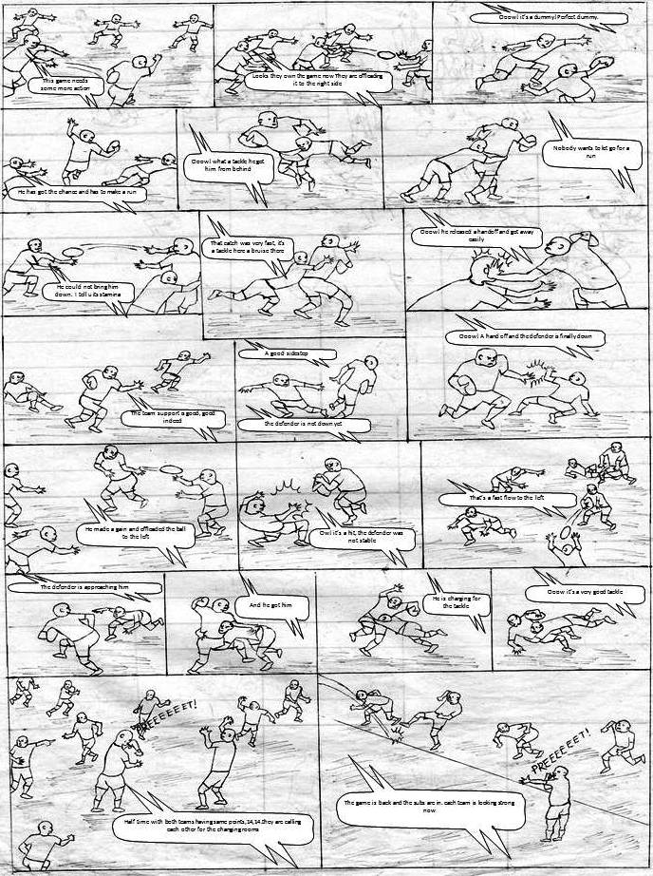

Slide 5
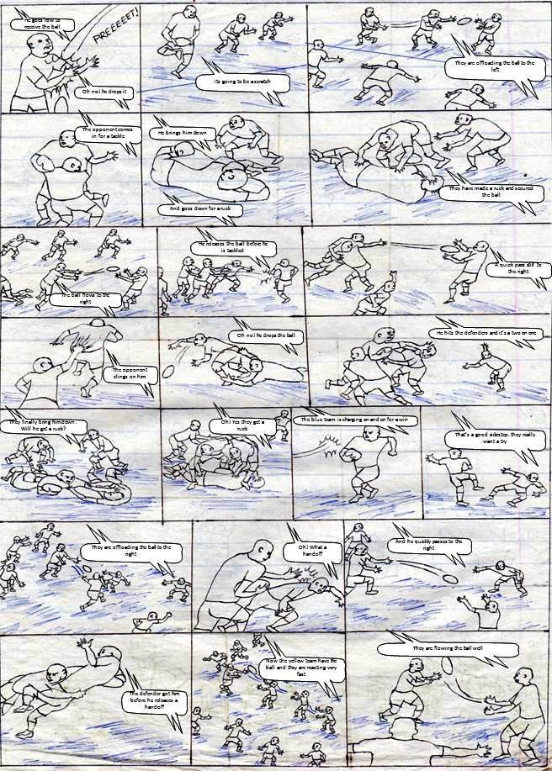

Slide 6
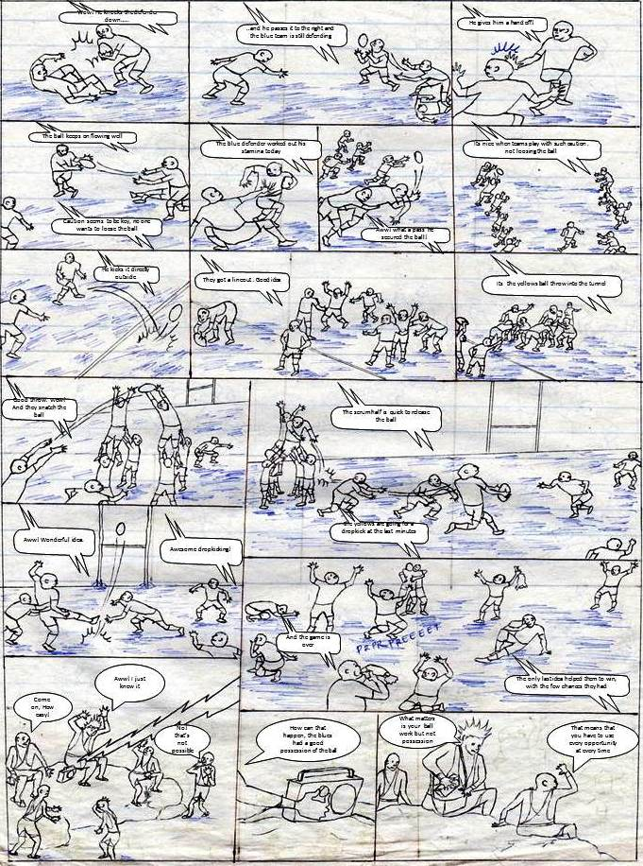

Slide 7
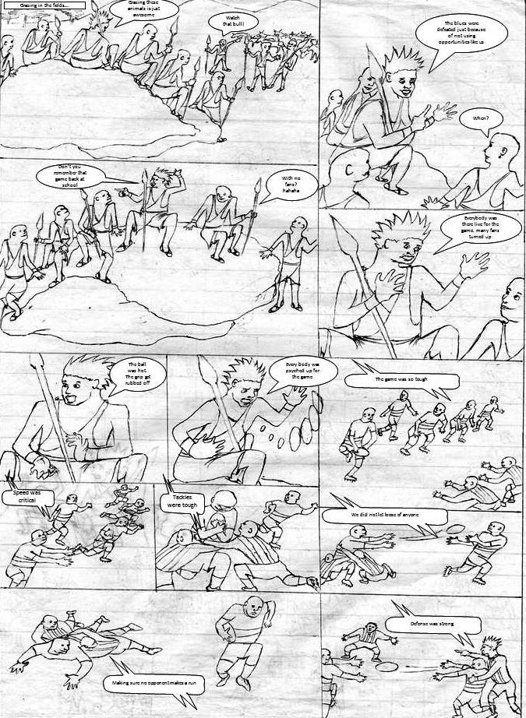

Slide 8
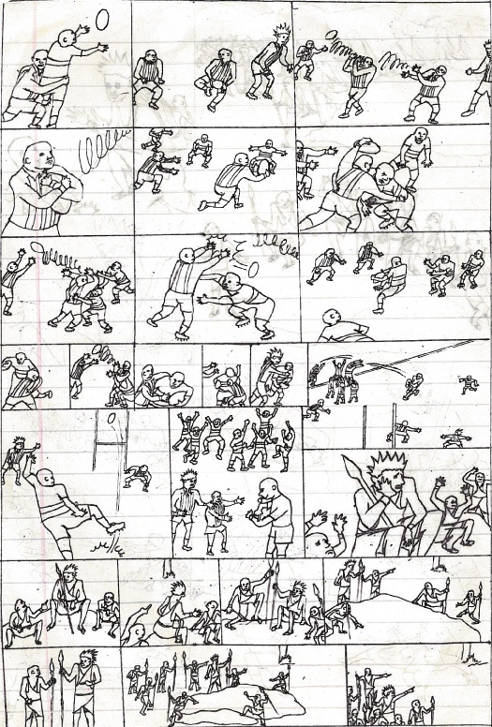
And we would take advantage
We used very high passes
Sometimes they would loose the ball
And we had good grip of the ball
Our attack would come in strong
And we would resist all tackles from them
Blind passes were futile at that time
Fear was in the air
Precision was key
Tackles got tougher
They would make use of the few chances they got
The game was fair
We lost but it was a lesson
And we lost the title
Yeah. I see that you remember it now man
And they also dropkicked in the last minute and won
We don’t have a ball. I lost it
Let’s try
That trees bark makes good drums
But we can try the game here
We can make another one from that tree’s bark
Very good drums
I know them man
Its not difficult
I am not sure it will work
Guys test your spears
That tree is the target

Slide 9
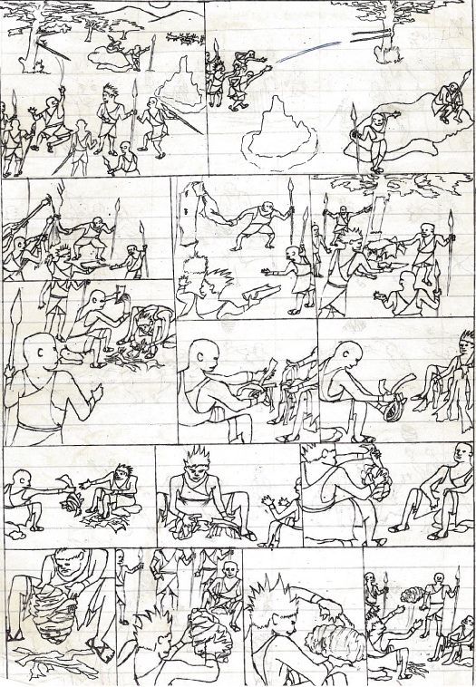
They remove the trees bark…
You see. Its hard to remove
Yeah we washed them yesterday
I throw it first
There you go kiala
Let me help
These cattle don’t need to be washed huh!
They peal it out…
Help me remove this one
Yeah, this is quite long
That’s enough
That is what we want
this can make two or three balls
We make two?
We made drums and sandals from this
And we sold them at the market place
Were those drums from this tree?
One ball is enough for us to play
Let me help you
Show me your technique
Yes, I will show you the technique
You have to squeeze hard and don’t leave any spaces
Yeah don’t leave those spaces
I squeezed it hard
There you go guys play it hard
This last wrap will do it for us
Truly it’s a grip bark
Good work

Slide 10
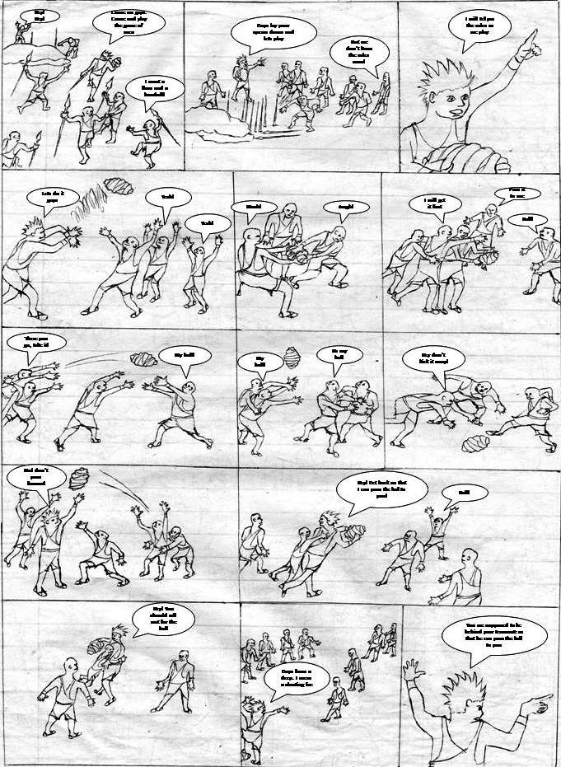

Slide 11
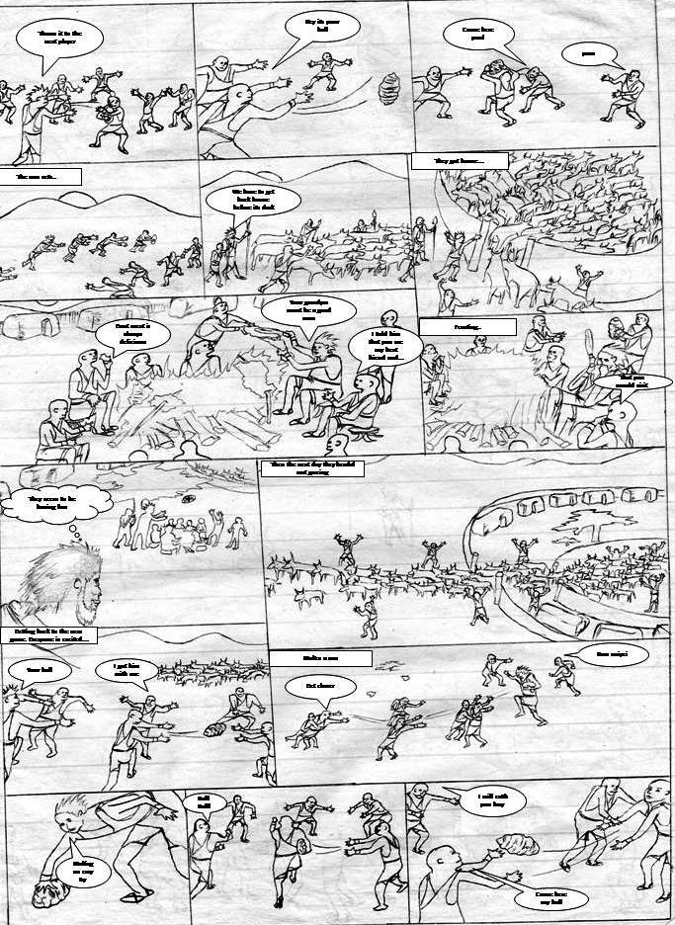

Slide 12
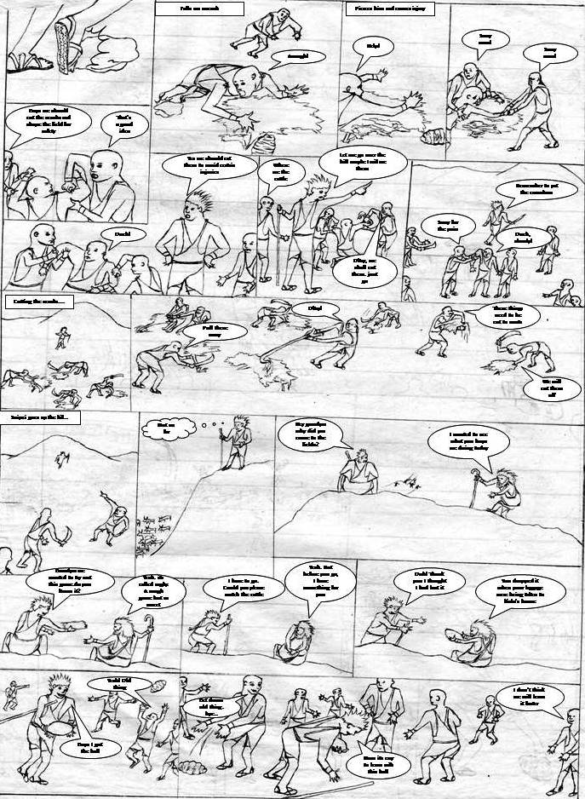

Slide 13
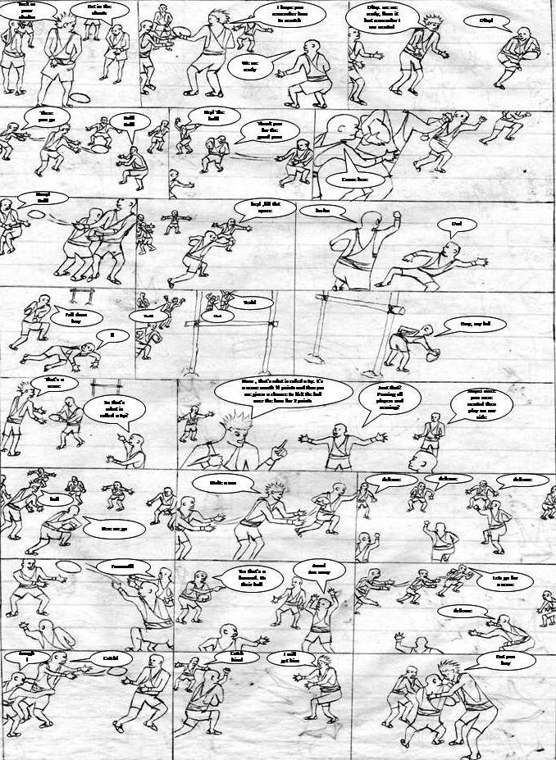

Slide 14
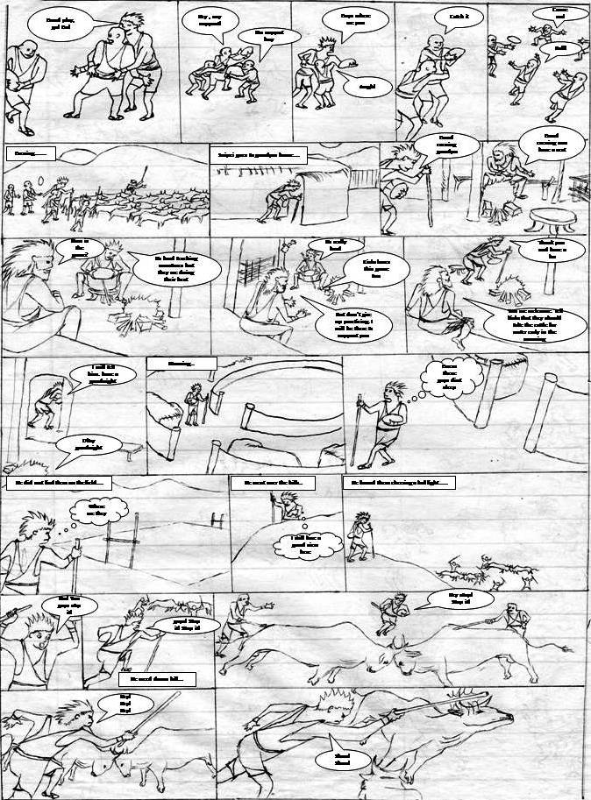

Slide 15
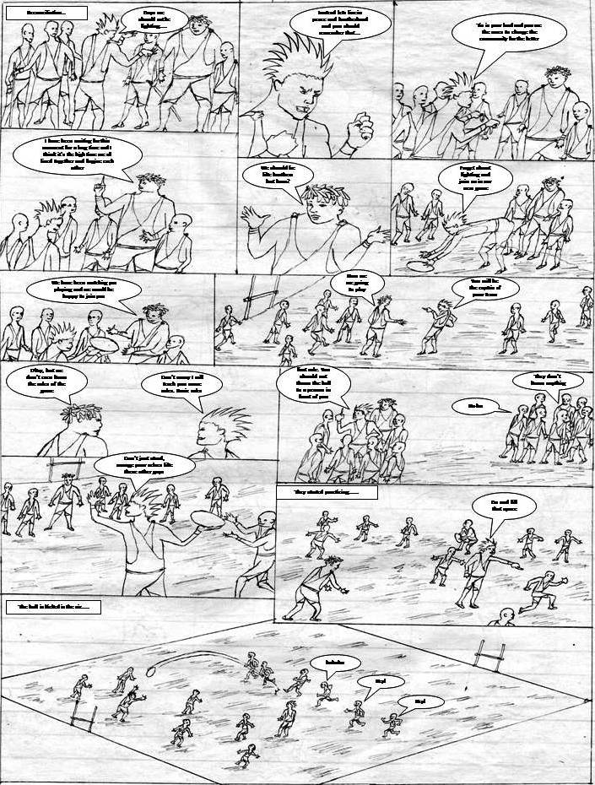

Slide 16
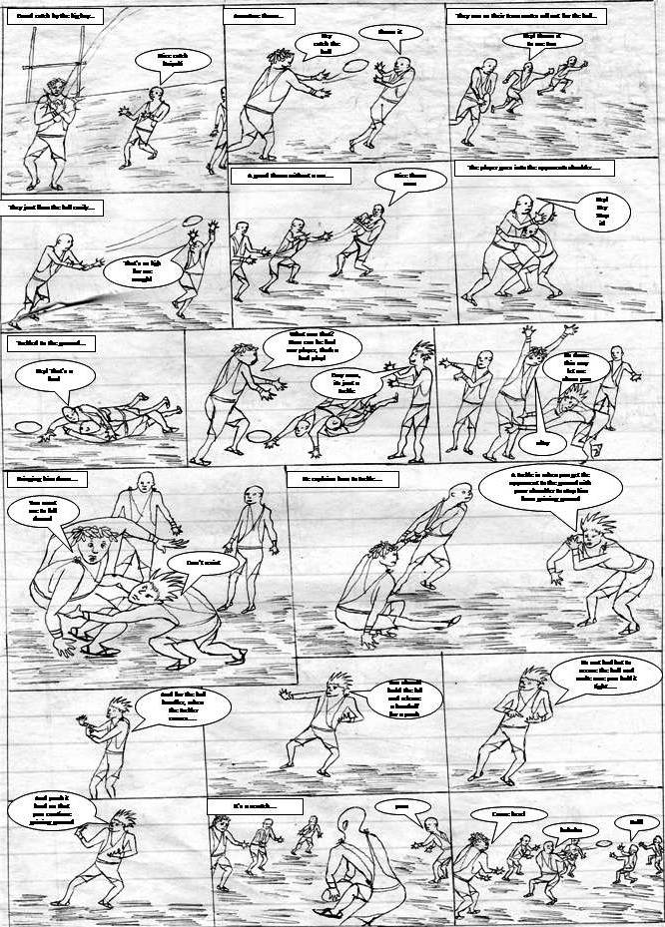

Slide 17
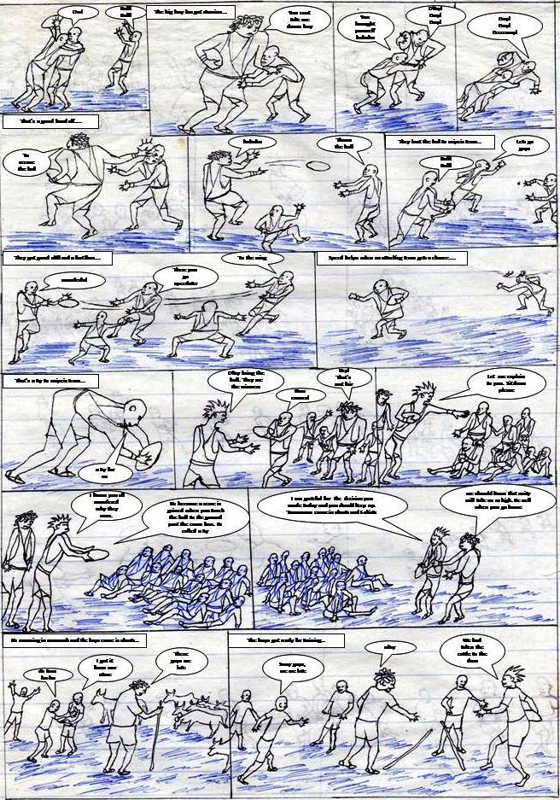

Slide 18
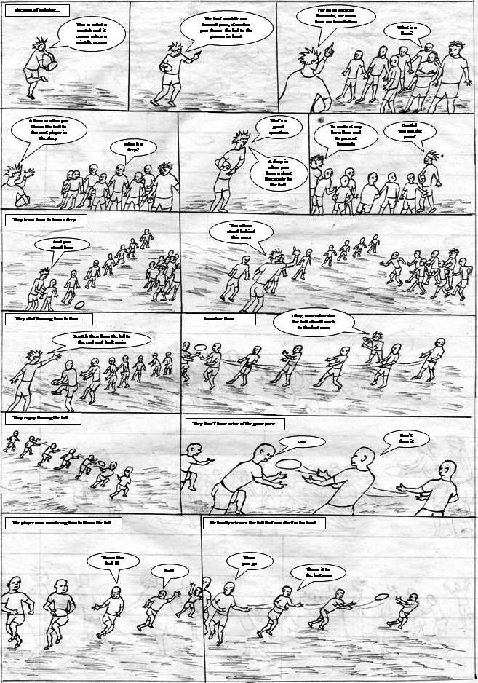

Slide 19
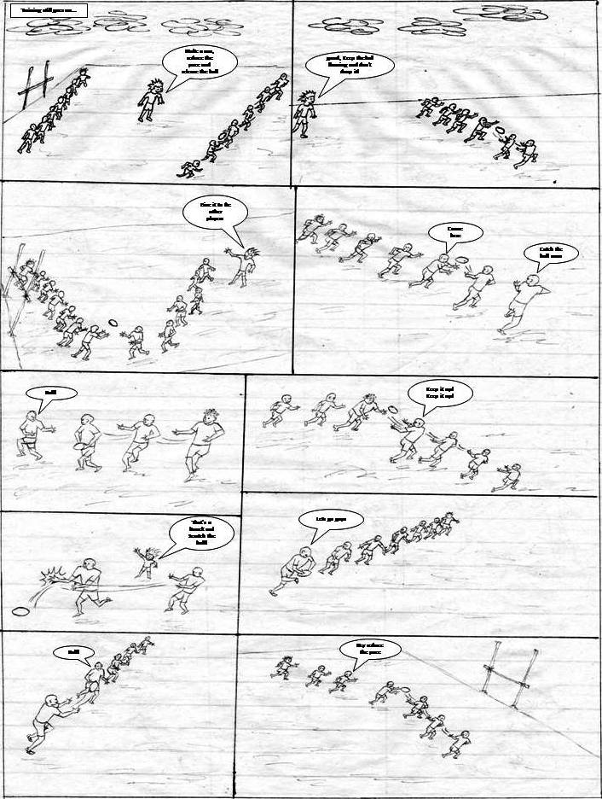

Slide 20
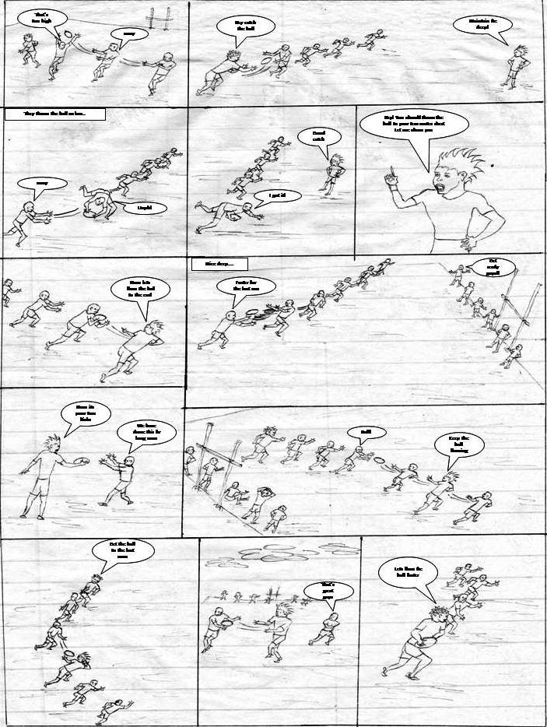

Slide 21
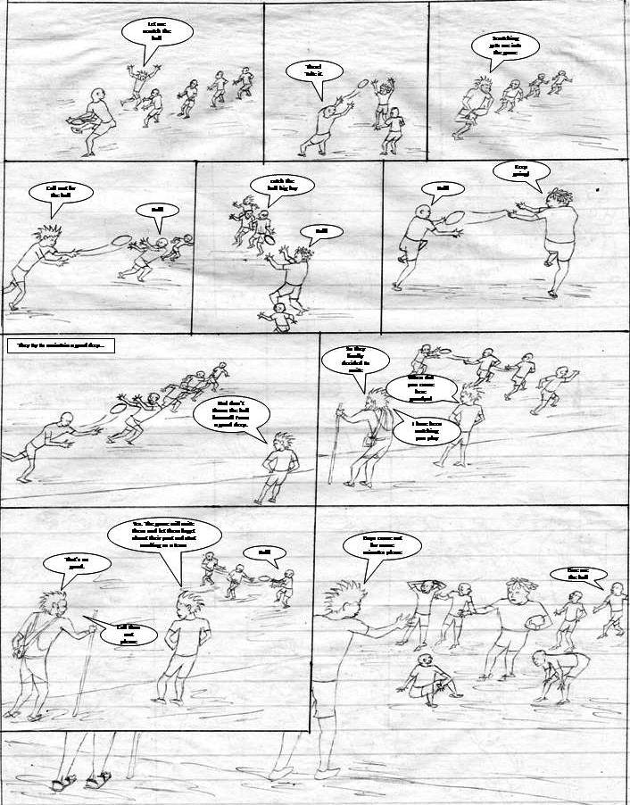

Slide 22
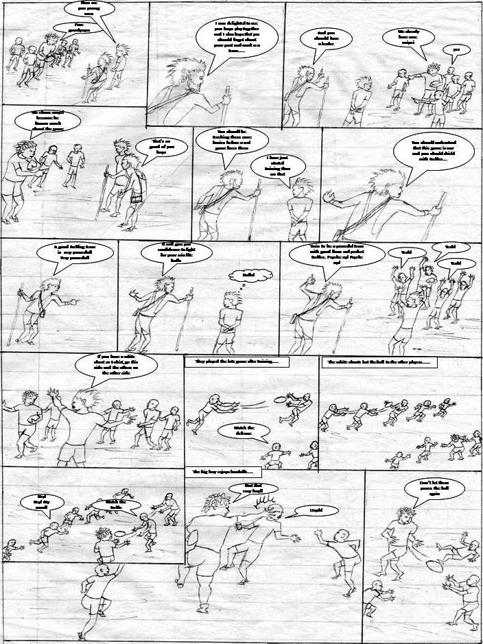

Slide 23
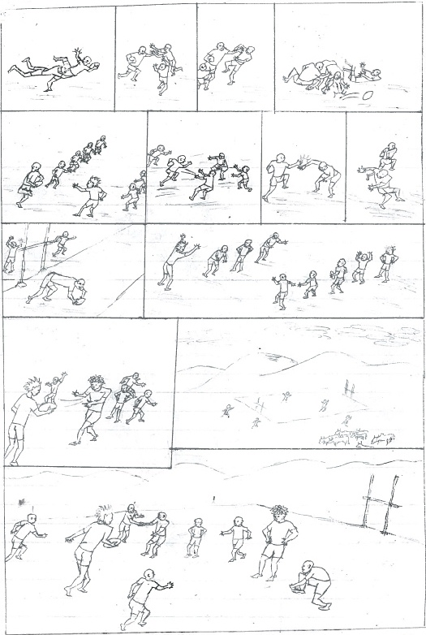
Experienced amateur tackles
I will push both of you
A stretch for you and….
Catch him from that side
Ow! Please! Please!
And a tackle for you boy
Aaargh! The ball
No making a run boy
Aaaaaargh!
They got a chance for the ball, any game play??
Don’t be sure for a tackle
Come on easy catch!
And he delivers a push to weaken the tackle……
A tackle indeed. Go down mr.
Hurry up I have seen a weak point
Scratch the ball guys
Yeah, fire up!
Okay guys. Game over
We are the winners then
Ooow!
Cant we have the last play
Mount down my ball, a try for me
You see, you wasted us man.
The ball big boy, we will meet tomorrow for the full game
Okay man, I hope you will come early
A new day for the boys at the grazing fields……..
bye
bye
hey
Am good man
A rough day starts with you getting late first
Sorry guys we had gone to wash the cattle. You will have a rough day today
Guys, here we are
Easy boy, its too early to talk

Slide 24
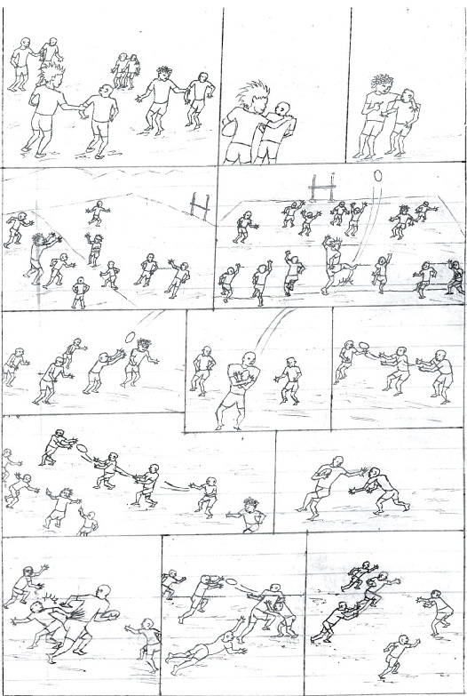
Pair up and choose between A and B
You choose first
Let me start, I choose B
I choose A….big mans priority
And I choose the A- side
Small mans despice, let me choose B
My ball, I will get it!
They divide themselves into two teams…
The game starts with a kick in the air
That’s your ball
A- team, come this side
All the B boys this side
Here we come
I thought this was A- side
You got the gap
Flow the ball
Throw the ball this side
Release the ball faster
I got it!
Hey, flow it faster!
Easy! I got it guys
Hurry please
Flow the ball to the wing
A stretch for you boy
Come here
Make the defense tight
Man On! Ball! Ball!
Throw the ball
The player could not speed up past the defense…
Reduce the pace !!!
I release the ball
Hey Faster, flow.
Cover up for the last man !!

Slide 25
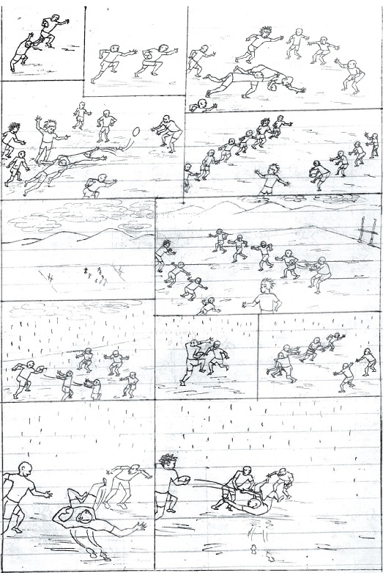
He managed to get away……
The player wasn’t fast enough
Hold the ball tight
Come here
Ow! Give me support guys
That’s a knock on, the ball is for the other side
Give ten……move five steps backwards
dark clouds appear to gather in the sky
The wind becomes stronger
The rough day is about to start
The rain has started falling but they keep on playing
Watch out for the wing
Bad weather is coming
They are playing like there is no rain at all
The ground is already soaked and the players are sliding
He still manages to save the ball and releases the ball on ground
Hahahahaha what did u think you were doing
That’s an easy tackle
Thanks man
Aaaaargh!

Slide 26
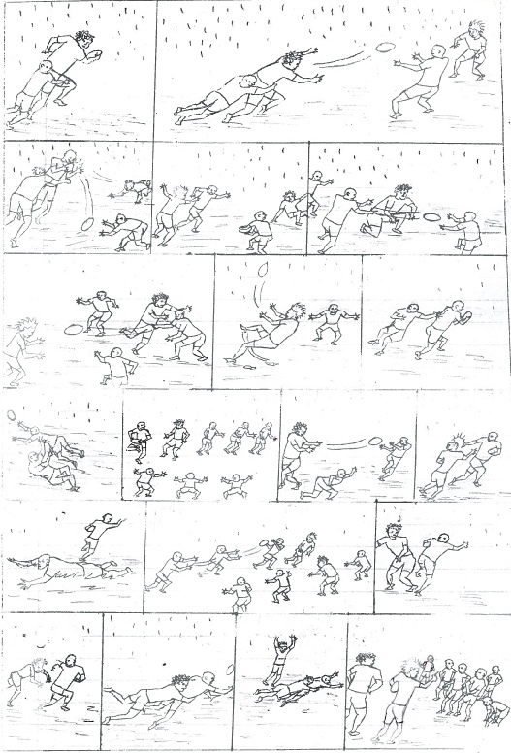
Aaaaaargh!
Ball!
Come on
Go down big boy
The game is getting tougher
Advantage! Play on, its our ball
Am going to get you boy
Ball!
Aaargh!
Ooooh no! he slid and lost the ball
The opponents now have the ball
You should have let it flow to the end
Aaaaagh!
That’s a hard tackle
They are trying to organize themselves
The ball flows perfectly
Aaw! He releases a nice handoff !!
And he is free to make a run
The ball is being offloaded to the left after loosing it
Aaaw! That’s a good sidestep
I will still get you !!
Aha! That’s a good tackle. Come over here guys
You guys played very well. Tomorrow lets meet again for more practice
Come here you small thing
Aaaaaaargh!

Slide 27
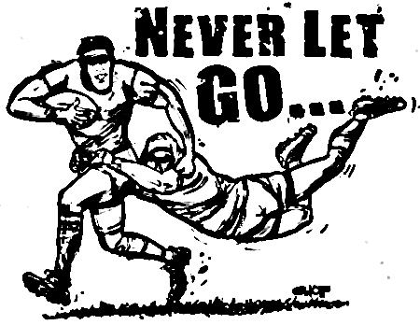
WE SCRUM FOR POSESSION RUN FOR THE TRY ZONE BLEED FOR THE TEAM AND LIVE FOR THE GAME
YOU EITHER LOVE RUGBY OR YOU’RE WRONG
THE SCRUM AND THE TACKLE ARE THE TWO REALLY CONTENTIOUS AREAS OF THE GAME.IF YOU GET THOSE TWO ASPECTS RIGHT.MOST RUGBY MATCHES WILL WORK IN YOUR FAVOR
TOUGH ARCS IS BRINGING CHANGE TO WHAT THE SOCIETY THINKS OF RUGBY

Slide 28
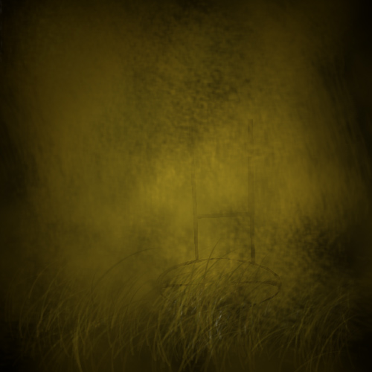


Tough arcs
@tough arcs

